Slide 1

Customer Retention
Created By – Kshitij Chawla

Slide 2
Problem Statement
Customer satisfaction has emerged as one of the most important factors that guarantee the success of online store; it has been posited as a key stimulant of purchase, repurchase intentions and customer loyalty. A comprehensive review of the literature, theories and models have been carried out to propose the models for customer activation and customer retention. Five major factors that contributed to the success of an e-commerce store have been identified as: service quality, system quality, information quality, trust and net benefit. The research furthermore investigated the factors that influence the online customers repeat purchase intention. The combination of both utilitarian value and hedonistic values are needed to affect the repeat purchase intention (loyalty) positively. The data is collected from the Indian online shoppers. Results indicate the e-retail success factors, which are very much critical for customer satisfaction.

Slide 3
Conceptual Background of the Domain Problem
The project will require knowledge and practice in building Graphs /plots and analysing them to get the relationship between dataset, Knowledge of Different Learning Models to build and predict the required output. Basic Data science concepts to increase the quality of the dataset and Python Knowledge (Coding Language) which will be used to solve the complete Micro Credit Defaulter project. Understanding of calculating F2 score, accuracy, skewness and basic mathematics/statistical approaches will help to build an accurate model for this project.

Slide 4
Exploratory Data Analysis performed on the dataset
1) Checked the shape of the dataset : We have 269 rows and 71 columns in our dataset
2) Checked the datatypes of the columns:
Dataset contains both integer and categorical values
3) There are 0 null values and repeated rows in the dataset
4) There are repeated rows in the dataset
5) Outlier is present in ‘What is the Pin Code of where you shop online from?’

Slide 5
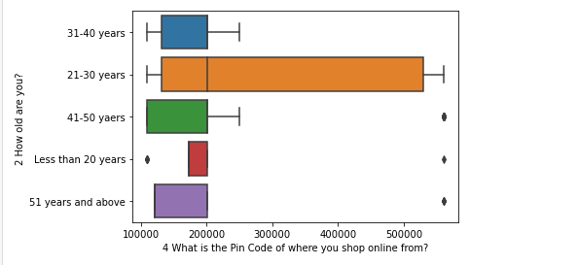
Exploratory Data Analysis performed on the dataset
Outliers Example from our dataset –

Slide 6
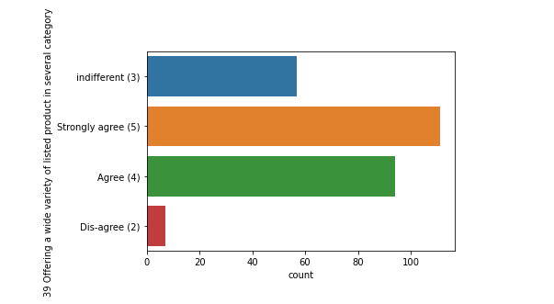
Univariant Analysis on the dataset
Univariant Analysis Example from our dataset –

Slide 7
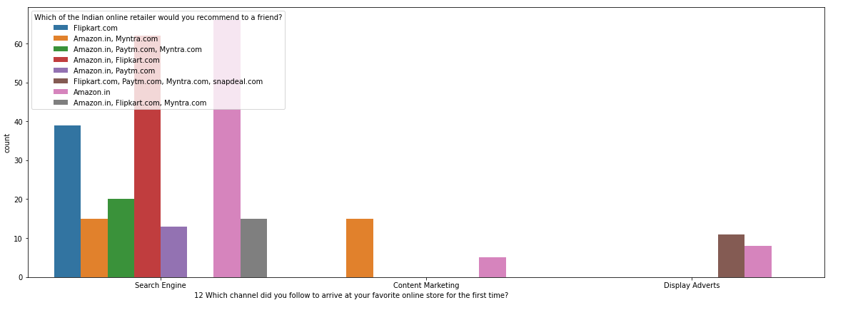
Bivariant Analysis on the dataset
Bivariant Analysis Example from our dataset –

Slide 8
Key Analysis Conclusion on the dataset
We could observe –
Most of the surveys are from Female
In data set we have majority of people in 31-40years age group
Most of the people are shopping online for above 4 years
Most of the people had less than 10 times purchase online for past 1 year
Most of the users use Mobile Internet
Most of the users use Smartphone to order online
Most of the users use Google Chrome Web browser for ordering
Most of the users explore for more than 15 min before making purchase
Preferred payment option for most users is Credit/Debit cards
Most preferred portal is Amazon and flipkart

Slide 9
Key Analysis Conclusion on the dataset
We could observe –
Most of the Users suggests the portal which is easier to use i.e Amazon and Flipkart
Most of the Users suggests the portal which have best visual appeal i.e Amazon and Flipkart
Most of the Users suggests the portal which have variety of products i.e Amazon and Flipkart
Users recommend those portals which have wide variety of products i.e Amazon and Flipkart
Most of the users recommended Amazon by considering one paramter as it is fast loading
Most of the users recommended Amazon as it is reliable and quicker to complete the purchase
Amazon have the best delivery as per the users
Amazon and Flipkart are recommended asthe users details are kept confidentials and have full privacy

Slide 10
Thank you

